Slide 1


Master’s Thesis in Economics
The determinants of corporate bond spreads in local currency in Brazil: a panel study 2010-2025
103
48
4,229
2010-2025
IPCA-linked bonds
issuers
monthly observations
sample period
Student: Thiago da Silva Siqueira
Professor: Prof. Dr. Martín Grandes
Buenos Aires, December 23, 2025
Notes:
Good afternoon, thank you very much for your time. This paper analyzes the macroeconomic determinants of corporate debt spreads in local currency in Brazil, with a focus on IPCA-indexed corporate bonds over the period 2010–2025. The central objective is to understand which factors (global, sovereign, and idiosyncratic) explain the cost of real corporate financing in an emerging economy that has a relatively deep local-currency debt market.

Slide 2
Bird view
What
Local-currency corporate bond spreads in Brazil IPCA-linked, non-financial issuers 2010-2025 monthly panel
Brazil is a large and expanding EM local debt market
Evidence on local-currency corporate debt remains limited
Bond-level fixed effects panel
Real risk-free curve: WLA + NTN-B + Nelson-Siegel
Robustness: PCSE and Driscoll-Kraay
Macro and global factors dominate
FX and GDP are robust real channels
Sovereign-corporate relation is non-mechanical
Why
How
Outcome
Main message
In Brazil, IPCA-linked corporate spreads are shaped by global monetary conditions, exchange-rate stress, domestic real activity, fiscal risk, and liquidity of issuance.
The non-standard negative relation between synthetic local-currency sovereign risk and corporate spreads is the key interpretive result.
Notes:
Before going into the details, let me give you an overview of the paper.
What I study: corporate debt spreads in local currency in Brazil, between 2010 and 2025.
Why it is relevant: because the evidence on local-currency corporate debt in emerging economies is limited, and because it is important to understand how global and sovereign shocks are transmitted to the corporate sector.
How I analyze it: using bond-level panel data with fixed effects, combining a systematic mapping of the literature with an empirical strategy and several robustness exercises.
And what I find: that macroeconomic and global factors dominate the formation of spreads, that the sovereign–corporate relationship is not standard, and that there are natural extensions of the analysis incorporating ratings and CDS.

Slide 3
What
Introduction
Research Objectives
Research Method (Empirical Strategy & Data Constr.)
Systematic Literature Review & Empirical Strategy
Data & Market Structure
Spread Construction / Variables
Methodology (FE + why not dynamic)
Main Results
Robustness Checks
Interpretation of Results
Extensions: Credit Ratings
Contributions & Limitations
Conclusion / Discussions
Roadmap
References
Why
How
Why + How
How
Agenda
Outcome
Notes:
This is the agenda for the presentation. First, I present the motivation and objectives of the paper. Then I explain the empirical strategy, including the literature review, data construction, and econometric methodology. In the second part, I show the main results, the robustness exercises, and their economic interpretation. Finally, I discuss possible extensions of the analysis and conclude with the main contributions and limitations.

Slide 4
Introduction
based on Durbin & Ng (2001); Grandes & Peter (2005); Liu & Spencer (2013)
GLOBAL FINANCIAL CONDITIONS
BRAZIL COUNTRY RISK / MACRO / BOND / FIRM
CORPORATE BOND SPREADS (BRL, IPCA)
Sovereign risk in local currency: Synthetic CDS BRL
Exchange rate (USD/BRL): Balance-sheet & risk perception channel
Real economic activity: GDP growth and default expectations
Issue size/assets; leverage; liquidity; maturity
Spread = Corporate YTM - IPCA real risk-free curve
Observed in:
IPCA-linked corporate bonds
Non-financial firms
Brazil, 2010-2025
Reflects:
Global conditions
Sovereign risk
Local macro environment
(Examples: utilities, infrastructure, transportation issuers)
Risk appetite/risk-off: VIX
US monetary cycle / global liquidity: Fed 3M Forward
based on González-Rozada & Levy-Yeyati (2008); Grandes et al. (2017)
Notes:
In this slide, I present the basic conceptual framework of the paper. The central idea is that local-currency corporate debt spreads arise from the interaction between two main blocks. On the one hand, global financial conditions, captured by global risk aversion (measured by the VIX) and by the U.S. monetary policy cycle, through the three-month forward rate. On the other hand, Brazil’s local and sovereign factors, which include local-currency sovereign risk, the exchange rate as a channel of risk perception and balance-sheet effects, and the evolution of real economic activity. The combination of these factors is reflected in the spreads of IPCA-indexed corporate bonds, which measure the cost of real corporate financing in Brazil over the period 2010–2025.

Slide 5
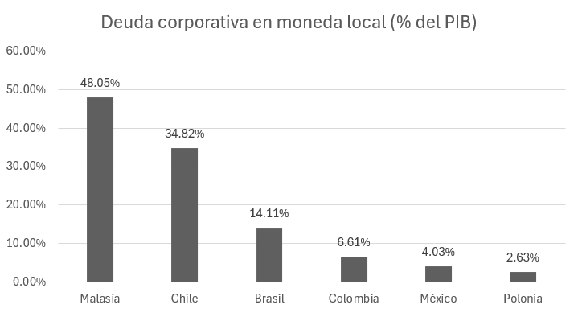
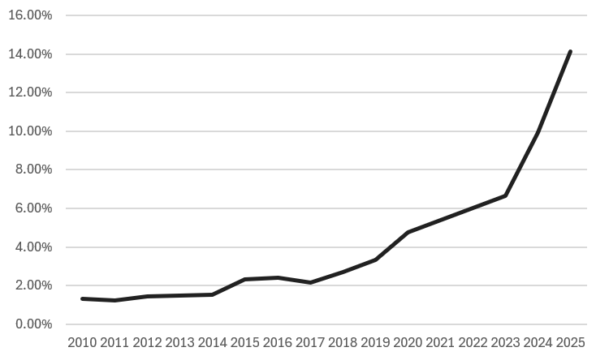
Why Brazil? A large and fast-growing local-currency bond market
Key takeaways
- Brazil is not the deepest market relative to GDP, but it is economically large and relevant among emerging markets.
- The local-currency corporate bond stock rises from roughly 1.3% of GDP in 2010 to about 14.1% in 2025.
- This creates a useful laboratory to study corporate spread formation in local currency.
Source: thesis, based on Bloomberg BQL and World Bank GDP data.
Master Thesis - Economics UBA
Notes:
This slide updates the motivation by adding the descriptive evidence from the thesis. The left chart shows market depth relative to GDP for selected emerging markets. The right chart shows the sustained expansion of the Brazilian local-currency corporate bond market from 2010 to 2025. This strengthens the motivation for studying Brazil as a relevant emerging market laboratory.

Slide 6
Research Objectives
Main objective:
To identify and quantify the global, sovereign, and idiosyncratic determinants of corporate bond spreads in local currency (BRL) in Brazil, using bond-level panel data over the period 2010-2025.
Conceptual & empirical groundwork: Identify, from the literature, the main global, sovereign, and firm-level factors associated with corporate bond spreads in emerging markets.
Market structure & measurement: Construct a consistent measure of corporate bond spreads in real terms, accounting for the OTC structure of the Brazilian market and the absence of an observable real risk-free curve.
Empirical model & estimation: Specify and estimate an econometric panel data model to evaluate the impact of global financial conditions, sovereign risk, and idiosyncratic factors on corporate bond spreads.
Validation & robustness: Assess the robustness and stability of the results using alternative specifications and estimators.
Notes:
Building on this conceptual framework, the main objective of the paper is to identify and quantify the global, sovereign, and idiosyncratic determinants of local-currency corporate debt spreads in Brazil. To achieve this objective, the paper is organized into four components. First, it establishes the conceptual and empirical framework based on the literature, identifying the relevant factors in emerging economies. Second, it addresses the measurement problem by constructing a consistent measure of real spreads, taking into account the OTC structure of the Brazilian market. Third, it specifies and estimates the econometric model to assess the impact of the different factors on spreads. Finally, it evaluates the robustness of the results using alternative specifications and estimators.

Slide 7
Motivation: Research Questions
What are the main global, sovereign, and idiosyncratic determinants of corporate bond spreads in local-currency debt markets in Brazil?
How do corporate bond spreads react to global shocks, such as changes in the VIX or in international interest rates?
What role do firm- and bond-specific characteristics (such as leverage, liquidity, or maturity) play in determining corporate bond spreads?
What is the relationship between sovereign and corporate bond spreads in the Brazilian context?
Notes:
Antes de entrar na metodologia, vale organizar a pergunta central do trabalho. O objetivo é entender quais são os determinantes dos spreads corporativos em moeda local no Brasil, e isso envolve três dimensões: fatores globais, risco soberano e características específicas das empresas e dos títulos. É essa estrutura que vai guiar tanto as hipóteses quanto a análise empírica.

Slide 8
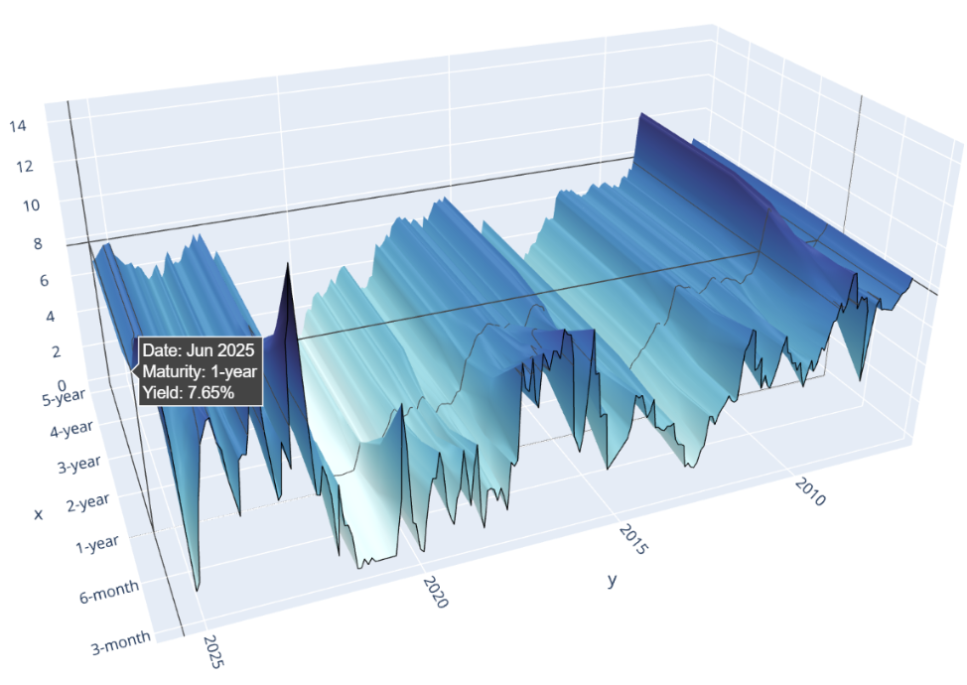
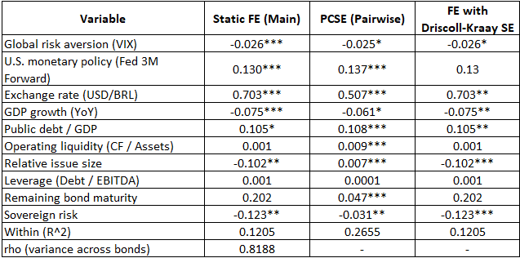
Research Method (Empirical Strategy & Data Construction)
Python: Data Ingestion (Data Sources & Market Structure)
Primary
market /
Issuance
Data/
Bond
Charact.
Secondary
Market
Prices (OTC)
Inflation-linked
Derivatives
Anbima
Exchange
B3
Issue Date
Maturity
Bradesco
Itau
Santander
+25
Price
Volume
Coupon
+30
Term
+25
Bloomberg
Main Bond Descriptions Database
Historical Bond Prices Database from Major Market Players
Future IPCA Contracts Database
Python / Stata:
Data Processing (
price consolidation &
yield computation &
econometrics )
Python*
Representative market price (per bond-date)
Python
Corporate bond yield (YTM)
Real risk-free curve (IPCA)
Python
DEPENDENT VARIABLE
Corporate bond spread
EXPLANATORY
VARIABLES
Global factors
Sovereign risk
Bond characteristics
Local macro conditions
Firm characteristics
VIX: Idx of global risk aversion
usd_brl: exchange rate
tot_debt_to_ebitda: leverage
liquidity: cash flow / assets
synthetic_cds_br
days_to_maturity
gdp_yoy: economic growth
Fed 3M Forward
economic sector
amount_issued_to_asset: size
Public debt/GDP
Stata / Microsoft Word:
Data Visualization (Estimation & results)
Results table with
Robustness check
*for further details, see the next slide “Screening Stage”
Notes:
This slide summarizes, in a schematic way, the empirical strategy and data construction. We start from issuance information and bond characteristics, secondary-market prices in a highly fragmented OTC market, and inflation-linked derivatives. From these sources, corporate yields are constructed, along with a real risk-free curve consistent with IPCA, and finally bond-level corporate spreads. These spreads are the dependent variable of the model and are explained by global factors, sovereign risk, local macroeconomic conditions, and bond- and firm-level characteristics. The purpose of this scheme is not to show every technical step, but to make clear that the analysis relies on a consistent and transparent data construction.

Slide 9
Data Screening and sample construction
6,926
1,220
103
4,229
initial local-currency corporate bonds
IPCA-linked non-government universe
valid bonds after filters
monthly observations
Step
Filter / decision
Purpose
1
Start from domestic corporate bonds in BRL
Define the broad local-currency universe.
2
Keep fixed-coupon, IPCA-linked instruments
Focus on real financing cost and comparable indexation.
3
Exclude government-backed and financial issuers
Keep non-financial corporate risk as the object of study.
4
Require accounting variables, price continuity and liquidity
Reduce missing data, bad prints and OTC pricing noise.
5
Remove yields and spreads with quality problems
Build a stable panel for econometric estimation.
Market structure to keep in mind
- OTC market: no centralized price formation.
- Multiple dealers and indicative quotes: price consolidation is part of the contribution.
- Uneven liquidity: robustness checks matter for inference.
5
Notes:
The revised presentation simplifies the screening stage. The initial universe has 6,926 local-currency corporate bonds. After focusing on IPCA-linked bonds, excluding government-backed and financial issuers, requiring accounting data and price quality, and removing pricing anomalies, the final panel has 103 bonds issued by 48 firms and 4,229 monthly observations. The market structure is important because this is an OTC market with indicative prices and uneven liquidity.

Slide 10
Anbima Systematic Bond
Screening
Data Screening and sample construction
6926 bonds
Excluded
Initial Bond Sample Extraction
No (5280 bonds)
Inclusion, Exclusion
and Quality Criteria Definition
Is it a fixed type
coupon?
Final econometric sample
103 bonds
48 Issuers
4229 observations
Yes (1646 bonds)
Retained
No
`(646 bonds)
Yes
`(103 bonds)
No
`(384 bonds)
Yes
`(1262 bonds)
Content Analysis
Excluded
Is it liquid and have no pricing anomaly” ?
Excluded
Is it an inflation linked bond (IPCA)?
Retained
No
`(42 bonds)
Yes
`(1220 bonds)
Retained
Excluded
Is it a government backed security?
Retained
Yes (749 bonds)
Financial statements (balance sheet) disclosed at CVM?
Financial
Non-Financial
102 bonds (8.4%)
Amt Issued 14 Bi
1118 bonds (91.6%)
Amt Issued 444 Bi
No (369 bonds)
Excluded
Notes:
Starting from 6,926 securities, after restricting to fixed-rate, inflation-linked bonds and excluding government and financial issuers, we get 1,220 securities. Of those, only 8.4% belong to the financial sector, while 91.6% are non-financial corporates.

Slide 11
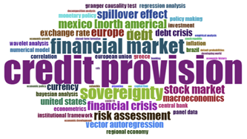
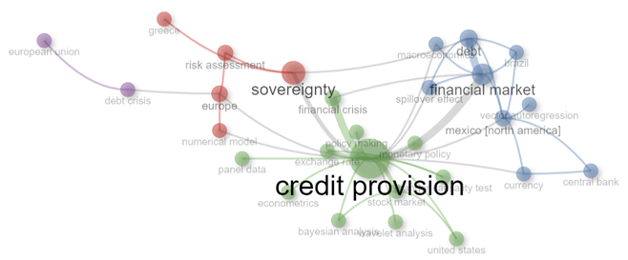
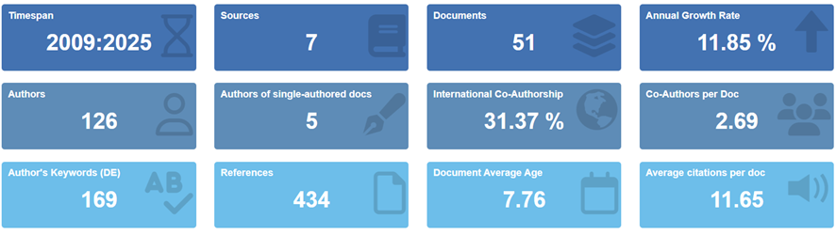











Systematic literature review & empirical strategy
Scopus query & corpus construction
Definition of research scope
  Corporate and sovereign credit spreads
  Emerging markets and Brazil
  Structured query in Scopus
  Filters applied
  Peer-reviewed journals
  Leading outlets in economics and finance
  Geographic focus on EMs / Latin America
  Export of records (.bib format)
  Construction of bibliographic corpus
Bibliometric + empirical modeling
Bibliometric analysis (R / bibliometrix):
  Term frequency
  Thematic mapping
  Evolution of topics
  Identification of:
  Main determinants studied in the literature
  Dominant theoretical lenses
  Translation into empirical strategy:
  Choice of variables
  Model specification
  Identification approach (panel FE)
Determinants & modeling choices
Key determinants highlighted in the literature:
  Global risk factors
  Sovereign risk
  Macro-financial channels
  Firm-level controls
  Identification of gaps:
  Local-currency corporate debt
  Brazil-focused evidence
  Bond-level panel data
  Resulting contributions:
  Empirical model design
  Robustness strategy
  Interpretation framework
Databases in academic research:
Tools:
Notes:
Before moving directly to the data and estimation, let me briefly explain how the literature informs the paper’s empirical strategy. A systematic literature review and bibliometric mapping exercise was conducted using Scopus, with a focus on sovereign and corporate spreads in emerging economies and in Brazil. This exercise makes it possible to identify the most commonly studied determinants in the literature (global factors, sovereign risk, macro-financial channels, and firm-level controls) while also detecting relevant gaps. In particular, the evidence on local-currency corporate debt, with a focus on Brazil and using bond-level data, is limited. This diagnosis directly guides the choice of variables, the model specification, and the identification strategy used in the empirical analysis.

Slide 12
Phase 1: Data & market structure
Data
Market structure
Sample: Brazilian non-financial corporate bonds
Currency & indexation: BRL, IPCA-linked only
Period: 2010-2025 (monthly)
Final sample:
103 bonds
48 issuers
4,229 observations
Predominantly OTC (Over-the-Counter) market
No centralized price formation
Prices reported by multiple dealers and institutions
High fragmentation and uneven liquidity
Data consolidation
Prices consolidated from up to 28 sources (Bloomberg)
For each bond-date:
select most reliable and continuous quote
filter outliers and bad prints
Ensures consistent time series for panel estimation
(Sources: Bloomberg, B3, ANBIMA, Central Bank of Brazil)
Notes:
In this first phase, I move on to describe the data and the market structure. The analysis is based on a monthly panel of non-financial corporate bonds in Brazil, denominated in reais and exclusively indexed to IPCA, covering the period from 2010 to 2025. The final sample includes 103 bonds issued by 48 firms, with just over 4,200 monthly observations. It is important to note that this is a predominantly OTC market, with no centralized price formation, where quotes come from multiple dealers and institutions and liquidity is heterogeneous. For this reason, a central part of the paper consists of consolidating prices from up to 28 different sources, selecting for each bond and date the most reliable and continuous quote, and filtering outliers. This procedure makes it possible to construct consistent time series for the estimation of the panel data model.

Slide 13
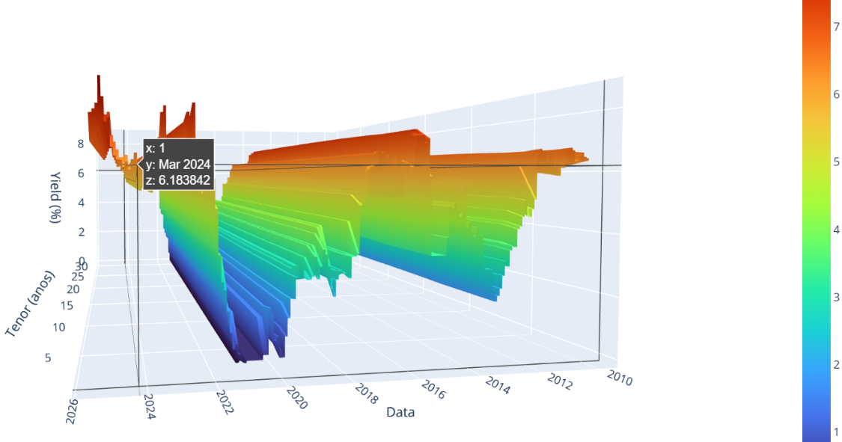
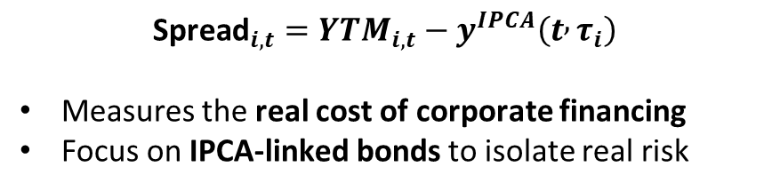
Phase 2: Spread construction and variables
Corporate bond spread
Real risk-free curve (IPCA)
$${\text{Spread}}_{i,t}=YTM_{i,t}−y^{IPCA}\left(t , τ_{i}\right)$$
Measures the real cost of corporate financing
Focus on IPCA-linked bonds to isolate real risk
0-5 years: WLA Index (DI X IPCA futures)
5-15 years: NTN-B sovereign bonds
Curve extended using Nelson-Siegel
Smooth matching at 5-year tenor
Key explanatory variables
Global factors
VIX (global risk appetite)
Fed 3M Forward (international monetary cycle)
Sovereign & local macro
Synthetic CDS BRL(sovereign risk in local currency)
USD/BRL ( balance-sheet & risk perception channel)
GDP YoY (real activity & default expectations)
Firm / bond characteristics
Issue size / assets (liquidity)
Leverage
Time to maturity
(Comments: Detailed construction in Technical Appendix)
Notes:
In this second phase, I explain how the spread is constructed and which explanatory variables are included in the model. The corporate spread is defined as the difference between the yield on the corporate bond and a real risk-free curve consistent with IPCA. In this way, the spread measures the cost of corporate financing in real terms. The exclusive focus on IPCA-indexed bonds makes it possible to isolate real credit risk, avoiding contamination from inflation or nominal monetary policy. To construct the real risk-free curve, IPCA futures are used at the short end (up to five years) and sovereign NTN-B bonds at the long end, extending the curve using a Nelson–Siegel approach and ensuring a smooth transition at the splice point. As for the explanatory variables, they are grouped into four blocks: global factors, sovereign risk and local macroeconomic conditions, and bond- and firm-level characteristics. This classification reflects the different channels through which spreads are formed, which are then evaluated empirically in the model.

Slide 14
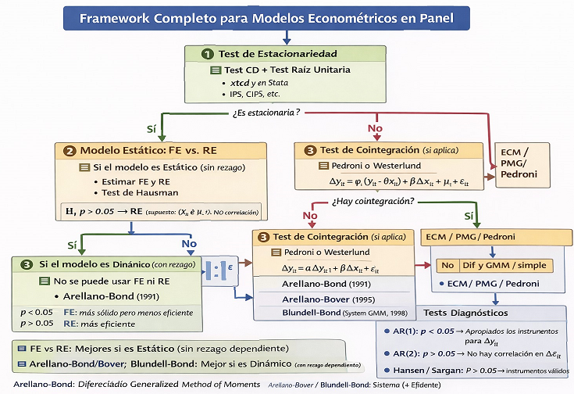
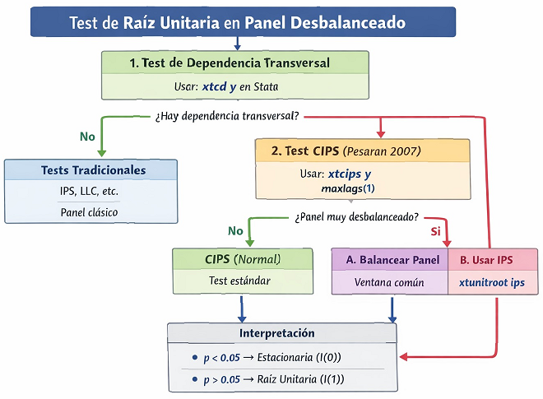
Phase 3: Methodology (FE + why not dynamic)
Model decision tree
Stationarity check
Notes:
In this third phase, I turn to the econometric methodology. The baseline model is a static panel with bond-level fixed effects, estimated using monthly data from 2010 to 2025 and with standard errors clustered at the issuer level. The choice of fixed effects is motivated by strong unobserved heterogeneity across bonds and issuers: around 82% of the variance of spreads is explained by structural differences between bonds. In addition, the Hausman test rejects the random-effects specification, indicating that these unobserved characteristics are correlated with the regressors. As for dynamic models, they were considered as an alternative, but in this context the lagged spread mechanically dominates the regression, with a coefficient close to 0.9. This reflects frictions inherent to the OTC market and reduces the interpretability of the economic channels. For this reason, the dynamic model is used only as a robustness exercise, while the static fixed-effects model is adopted as the main specification.

Slide 15
Phase 3: Methodology (fixed effects with robustness checks)
Baseline econometric model
Static panel model in levels, monthly bond-level data.
Bond fixed effects control for time-invariant heterogeneity across bonds and issuers.
Inference starts with issuer-clustered standard errors.
Diagnostic
Result
Implication
F test
Pooled vs FE rejected
Bond heterogeneity matters.
Why Fixed Effects?
Hausman
RE rejected
FE preferred.
Strong unobserved heterogeneity across bonds and issuers (ρ ≈ 0.82 of total variance)
Structural characteristics (sector, governance, contract design) are correlated with regressors
Hausman test rejects Random Effects
FE isolates within-bond variation, identifying macro and sovereign effects
Modified Wald
Heteroskedasticity
Robust inference needed.
Pesaran CD
Cross-sectional dependence
Use PCSE / Driscoll-Kraay checks.
Wooldridge
Serial correlation
Robust covariance checks.
rho
0.8188
High structural component across bonds.
Why not make dynamics the core?
Panel is strongly unbalanced and monthly prices come from an OTC market.
Stationarity tests are difficult to apply consistently to the full sample.
The thesis keeps levels specification, consistent with spread literature.
(Comments: Alternative estimators shown in robustness slide)
Notes:
In this third phase, I turn to the econometric methodology. The baseline model is a static panel with bond-level fixed effects, estimated using monthly data from 2010 to 2025 and with standard errors clustered at the issuer level. The choice of fixed effects is motivated by strong unobserved heterogeneity across bonds and issuers: around 82% of the variance of spreads is explained by structural differences between bonds. In addition, the Hausman test rejects the random-effects specification, indicating that these unobserved characteristics are correlated with the regressors. As for dynamic models, they were considered as an alternative, but in this context the lagged spread mechanically dominates the regression, with a coefficient close to 0.9. This reflects frictions inherent to the OTC market and reduces the interpretability of the economic channels. For this reason, the dynamic model is used only as a robustness exercise, while the static fixed-effects model is adopted as the main specification.

Slide 16
Phase 3: Main results
Global & macro factors dominate
Sovereign risk: a non-standard result
Fed 3M Forward: positive and statistically significant (tighter global monetary conditions increase spreads)
USD/BRL depreciation: large positive effect (exchange rate is a key macro-financial channel)
GDP growth (YoY): negative and significant (stronger real activity reduces perceived credit risk)
Synthetic CDS BRL: negative and significant
Corporate spreads do not follow a mechanical sovereign ceiling
Suggests non-linear or portfolio-rebalancing effects in IPCA-linked bonds
Firm & bond characteristics
Issue size / assets: negative and significant (liquidity effect dominates)
Other firm-level variables: not robust
Macro and global factors explain most of the variation
(Comments: FE with issuer-clustered SEs; robustness discussed next)
Notes:
I now turn to the main results of the fixed-effects model. The first clear message is that global and macroeconomic factors dominate the formation of local-currency corporate spreads. In particular, a tightening of international monetary conditions (captured by the three-month Fed forward rate) significantly increases spreads. Likewise, an exchange rate depreciation has a strong positive effect, confirming that the exchange-rate channel is central to corporate risk. By contrast, stronger economic growth reduces spreads, consistent with lower default expectations.
A second important result concerns local-currency sovereign risk. The coefficient on the synthetic sovereign CDS is negative and statistically significant, implying that corporate spreads do not mechanically follow the traditional sovereign ceiling approach. This is a non-standard result, suggesting the presence of non-linear effects or portfolio rebalancing in the IPCA-linked bond segment. Finally, among bond- and firm-level variables, the relative size of the issuance is the only robust determinant: larger issues exhibit lower spreads, pointing to a liquidity effect. Overall, the results indicate that macroeconomic and global factors explain most of the variation in spreads.

Slide 17
Phase 3: Robustness Checks and Economic Interpretation
Specifications
Robustness Table: Econometric Comparison (FE vs PCSE vs DK)
Robustness supports FE as the baseline model
              Panel-Corrected Standard Errors (PCSE) and FE + Driscoll-Kraay SE as robustness checks
PCSE unstable in large-N, unbalanced OTC panel
Static FE remains the most interpretable and stable specification
Interpretation
Finding
Interpretation
How to phrase it
FX channel is strong
USD/BRL depreciation increases spreads even though bonds are in BRL.
FX acts as a macro-financial stress proxy, not only a balance-sheet mismatch channel.
Real activity matters
GDP growth reduces spreads by improving expected repayment capacity.
A stronger real cycle lowers perceived credit risk.
Fiscal risk matters
Debt/GDP is positive and significant across robustness checks.
Fiscal conditions affect the pricing of corporate risk.
Sovereign risk is non-standard
Synthetic CDS BRL has a negative coefficient.
The sovereign ceiling is not mechanical in IPCA-linked local debt.
Liquidity dominates firm accounting
Issue size matters more than debt/EBITDA or operating liquidity.
Market microstructure and secondary-market liquidity are important.
Notes:
In this slide, I present the main robustness exercises. Alternative specifications were estimated, including a fixed-effects model with a lagged spread and PCSE estimators with different correlation structures. The first important result is that the signs and significance of the main determinants are generally preserved. However, when the lagged spread is included, it dominates the regression with a coefficient close to 0.9, reflecting mechanical persistence associated with price frictions in an OTC market rather than an economic adjustment process. The PCSE estimators prove to be unstable in this large and unbalanced panel. Overall, these exercises confirm that the static fixed-effects model is the most stable and interpretable specification, and therefore it is adopted as the baseline model.

Slide 18
Phase 3: Interpretation of Results
Global and macro dominance
Liquidity vs. fundamentals
Corporate spreads in BRL respond primarily to global monetary conditions and exchange rate movements
Local-currency corporate debt is not insulated from global financial cycles
FX acts as a key macro-financial transmission channel
Larger issues exhibit lower spreads due to higher secondary-market liquidity
Firm-level balance-sheet indicators add limited explanatory power
Structural issuer characteristics largely absorbed by bond fixed effects
Sovereign–corporate relationship
Role of market structure
Z
Negative coefficient on synthetic CDS BRL challenges the standard sovereign-ceiling view
Possible mechanisms:
    Portfolio rebalancing toward high-quality corporates during sovereign stress
    IPCA-linked corporates as relative safe assets in local currency
  Transmission is non-linear and market-segment specific
Observed persistence reflects OTC price frictions, not slow information adjustment
Pricing dynamics differ from exchange-traded or highly liquid markets
Notes:
In this slide, I move from the results to their economic interpretation. The first point is that local-currency corporate spreads respond mainly to global and macroeconomic factors, in particular to international monetary conditions and the exchange rate. This implies that local-currency corporate debt is not insulated from the global financial cycle, and that the exchange-rate channel plays a central role in the transmission of risk. Second, when we look at bond- and firm-level characteristics, issuance size emerges as the only robust determinant, suggesting that secondary-market liquidity is more relevant than traditional accounting indicators. Most other structural characteristics are largely absorbed by the fixed effects.
A particularly interesting result is the relationship between sovereign risk and corporate spreads. The negative coefficient on local-currency sovereign CDS challenges the traditional sovereign ceiling view. One possible interpretation is that, during episodes of sovereign stress, investors rebalance portfolios toward higher-quality corporates, especially in the IPCA-linked segment, which may function as a relatively safe local-currency asset. Finally, the persistence observed in spreads appears to reflect frictions inherent to the OTC market and price formation processes, rather than a slow adjustment to economic information.

Slide 19
Conclusions & contributions
Key takeaways
Brazilian local-currency corporate spreads are shaped less by short-run firm accounting variables and more by macro-financial conditions, real activity, fiscal risk, liquidity of issuance, and a segmented sovereign-corporate transmission mechanism.
Academic
Methodological
Applied / Professional
New evidence on local-currency corporate bond spreads in a major emerging market.
Challenges a mechanical sovereign-ceiling view in IPCA-linked debt.
Construction of a real risk-free curve (IPCA)(WLA + NTN-B + Nelson–Siegel)
Rigorous treatment of OTC price fragmentation
Bond-level panel approach with strong heterogeneity control (FE)
Insights for pricing, risk management, and relative-value strategies
Relevance for investors, issuers, and regulators in EM debt markets
Notes:
To conclude, I summarize the main conclusions and contributions of the paper. In terms of results, the central message is that local-currency corporate spreads in Brazil are determined primarily by global monetary conditions and the exchange rate. Once heterogeneity across bonds and issuers is controlled for, firm fundamentals play a secondary role. In addition, the sovereign–corporate relationship in IPCA-indexed bonds is not mechanical, and the OTC structure of the market is key to understanding the observed dynamics.
From an academic perspective, the paper provides new empirical evidence on local-currency corporate debt in a relevant emerging economy and challenges the traditional sovereign ceiling view in this market segment. From a methodological standpoint, it highlights the construction of a real risk-free curve consistent with IPCA and the rigorous treatment of prices in a fragmented OTC market, using a bond-level fixed-effects panel. Finally, from an applied perspective, the results are relevant for pricing, risk management, and relative-value strategies, and offer useful insights for investors, issuers, and regulators in emerging debt markets.

Slide 20
Limitations & Future research on Credit Ratings
Limitations
OTC market: prices are indicative, not transaction-level
Ratings not included in the baseline econometric model
Monthly frequency limits microstructure analysis
Results specific to IPCA-linked bonds in Brazil
Motivation
Proposed extension
Incorporate long-term local-currency ratings:
  Sovereign ratings
Corporate ratings
Focus on Brazil, 2010-2025
Track rating changes and persistence
Results suggest a non-standard sovereign-corporate transmission
Market-based measures (spreads) may react faster than ratings
Ratings capture structural, long-term credit risk
Research questions
Expected contribution
Do corporate spreads anticipate rating changes?
How closely do corporate ratings follow sovereign rating cycles?
Does the sovereign ceiling operate differently across rating tiers?
Bridge market signals vs. agency assessments
Clarify long-run sovereign-corporate linkage
Improve understanding of credit risk transmission in EM local-currency markets
(Comments: Extension complements current spread-based analysis)
Notes:
Before closing, I would like to briefly highlight some limitations of the analysis and a clear avenue for future research. Regarding limitations, the paper relies on indicative prices from an OTC market rather than on observed transactions. In addition, the baseline econometric model does not explicitly incorporate credit ratings, and the monthly frequency limits the analysis of market microstructure. Finally, the results focus on the segment of IPCA-indexed corporate bonds in Brazil.
These limitations, however, naturally motivate an extension of the work. The results point to a non-standard sovereign–corporate relationship, and it is possible that market-based measures (such as spreads) react more quickly than ratings, which capture long-term structural credit risk. A natural extension is to incorporate long-term local-currency ratings, both sovereign and corporate, for the period 2010–2025, and to analyze the dynamics of rating changes and persistence. In particular, this would make it possible to assess whether spreads anticipate rating changes, how corporate ratings follow sovereign rating cycles, and whether the sovereign ceiling mechanism operates differently depending on the rating level.

Slide 21
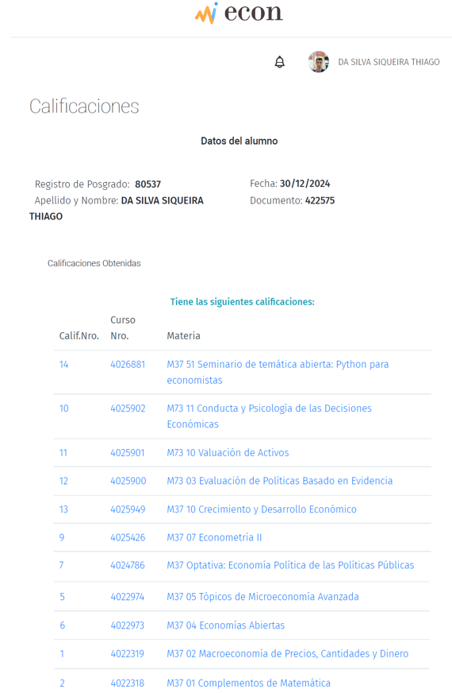
Roadmap
Papers
1# Del Campo al Mercado: Explorando las Dinámicas de las Cadenas Agroindustriales en Brasil; Economía Agropecuaria - Prof. Roberto Bisang
2# Análisis de Estados Financieros y Valuación de la Transportadora de Gas del Sur S.A; Valuación de Activos - Prof. Daniel Milia
3#:Understanding the Impact of Policy Decisions on Economic Performance: A Case Study of Brazil's Deindustrialization; Economía Política de las Políticas Públicas - Prof. Juan Pablo Gonzalez
4#:Cómo el efecto certeza y la percepción del riesgo moldean nuestras decisiones; Conducta y Psicología de las Decisiones Económicas - Prof. Pablo Javier Mira Llambi
Notes:
This is not part of the work presented today, but I include it as a reference to other academic projects I worked on over the course of the master’s program.

Slide 22
References
Arora, N., Gandhi, P., & Longstaff, F. A. (2012). Counterparty Credit Risk and the Credit Default Swap Market. Journal of Financial and Quantitative Analysis, 47(1), 119–138. https://doi.org/10.1017/S0022109011000590
Banco Central do Brasil (BCB). (varios años). Indicadores económicos y financieros. https://www.bcb.gov.br
B3. (2025a). Taxas referenciais DI x Pré – Histórico. Recuperado de: https://www2.bmf.com.br/pages/portal/bmfbovespa/boletim1/txref1.asp
B3. (n.d.). Taxas referenciais BM&FBOVESPA. B3 – Brasil, Bolsa, Balcão. Retrieved July 20, 2025, from https://www.b3.com.br/pt_br/market-data-e-indices/servicos-de-dados/market-data/consultas/mercado-de-derivativos/precos-referenciais/taxas-referenciais-bm-fbovespa/
Banco de Pagos Internacionales (BIS). (varios años). Base de datos de estadísticas macrofinancieras. https://www.bis.org/statistics/
Blundell, R., & Bond, S. (1998). Initial conditions and moment restrictions in dynamic panel data models. Journal of Econometrics, 87(1), 115–143. https://doi.org/10.1016/S0304-4076(98)00009-8
Carvalho, A. G. de, & Marques, F. T. (2020). The microstructure of the Brazilian market for corporate bonds. Revista Brasileira de Gestão de Negócios, 22(Special Issue), 482–500. https://doi.org/10.7819/rbgn.v22i0.4061
Duffie, D. (1999). Credit Swap Valuation. Financial Analysts Journal, 55(1), 73–87. https://doi.org/10.2469/faj.v55.n1.2240
Durbin, E., & Ng, D. (2001). The sovereign ceiling and emerging market corporate bond spreads: A new dataset and methodology (World Bank Policy Research Working Paper No. 2561). https://documents.worldbank.org/en/publication/documents-reports/documentdetail/372801468739801225
Espinoza, R. A., & Prasad, A. (2012). Sovereign credit ratings and spreads in emerging markets: Does investment grade matter? (IMF Working Paper No. 12/140). https://www.imf.org/en/Publications/WP/Issues/2016/12/31/Sovereign-Credit-Ratings-and-Spreads-in-Emerging-Markets-Does-Investment-Grade-Matter-25984
Fondo Monetario Internacional (FMI). (varios años). World Economic Outlook Database y International Financial Statistics. https://www.imf.org
Gómez-González, J. E., Uribe, J. M., & Valencia, O. M. (2022). Risk spillovers between global corporations and Latin American sovereigns: Global factors matter. Applied Economics, 55(13), 1477–1496. https://doi.org/10.1080/00036846.2022.2097193
González‐Rozada, M., & Levy Yeyati, E. (2008). Global factors and emerging market spreads. The Economic Journal, 118(533), 1917–1936. https://doi.org/10.1111/j.1468-0297.2008.02196.x
Grandes, M., & Peter, M. (2005). How important is sovereign risk in determining corporate default premia? The case of South Africa (IMF Working Paper No. 05/217). https://www.imf.org/en/Publications/WP/Issues/2016/12/31/How-Important-Is-Sovereign-Risk-in-Determining-Corporate-Default-Premia-The-Case-of-South-18634
Grandes, M., Panigo, D. T., & Pasquini, R. A. (2017). Corporate credit spreads and the sovereign ceiling in Latin America. Emerging Markets Finance and Trade, 53(5), 1217–1240. https://doi.org/10.1080/1540496X.2016.1174853
Insper. (2024a). DI Surprise as Monetary Policy Shock Identification: Brazil Case Study. CEFIN – Centro de Estudos em Finanças. https://cefim-insper.github.io/projects/DI_Surprise_MPshock.html
Insper. (2024b). Prêmio de Risco na Estrutura a Termo da Taxa de Juros: Uma aplicação ao Brasil (2005–2016). https://repositorio-api.insper.edu.br/server/api/core/bitstreams/2afa065a-aca4-48a6-9687-05d328b7df5b/content
JP Morgan. (varios años). EMBI Global Index.
Liu, Z., & Spencer, P. (2013). Modelling sovereign credit spreads with international macro-factors: The case of Brazil 1998–2009. Journal of Banking & Finance, 37(2), 241–256. https://doi.org/10.1016/j.jbankfin.2012.08.012
O’Kane, D. (2012). The CDS–Bond Basis. London: Risk Books.
OECD, ECLAC, CAF, & European Commission. (2024). Mercado de capitales [Capital Markets] (Chapter 3). In Latin American Economic Outlook 2024: Financing Sustainable Development (pp. 119–174). OECD Publishing. https://doi.org/10.1787/c437947f-en
Silva, E. O., & Paulo, W. L. (2015). Determinants of sovereign CDS spreads: Evidence from Brazil. International Business Research, 8(7), 102–112. https://pdfs.semanticscholar.org/1558/e90ca70eec0d1e1208ed07261f14ea76dee8.pdf
Wooldridge, J. M. (2019). Introductory Econometrics: A Modern Approach (7th ed.). Cengage.

Slide 23
Thank you!
Thiago Siqueira
Phone / Whatsapp: (55 11) 95344-7612
www.linkedin.com/in/thiago-siqueira
t_siqueira@hotmail.com
Notes:
Thank you for your attention.
I look forward to your comments and suggestions.

Slide 24
Defense map: literature, model, and findings
APPENDIX / Q&A
Mental map for Q&A: literature >>> mechanism >>> variable >>> result >>> concise answer
Central thesis
Brazilian IPCA-linked corporate bond spreads are shaped by global conditions, domestic macro-fiscal conditions, and issuance liquidity. The local-currency sovereign–corporate relationship is non-mechanical.
103
48
4,229
2010–25
bonds
issuers
obs.
monthly
1
Credit risk & liquidity
2
Global factors
3
Sovereign & macro
4
Econometrics
Key literature
Merton; Collin-Dufresne, Goldstein & Martin; Longstaff, Mithal & Neis; Carvalho & Marques.
Mechanism used
Spreads combine expected credit loss and liquidity premia. In an OTC market, price discovery and issuance depth matter.
Variables / model
Debt/EBITDA; cash flow/assets; issue size/assets; maturity; bond fixed effects.
Finding to defend
Larger issues carry lower spreads in FE and Driscoll–Kraay; accounting variables are not robust after fixed effects, and PCSE is more sensitive.
Key literature
González-Rozada & Levy Yeyati; Liu & Spencer; Gómez-González et al.
Mechanism used
Emerging-market financing costs respond to the global financial cycle even when debt is denominated in local currency.
Variables / model
VIX and Fed 3M Forward.
Finding to defend
Fed 3M Forward is positive in every model—significant in FE and PCSE, but not Driscoll–Kraay. The VIX coefficient is negative, contrary to the standard prior.
Key literature
Durbin & Ng; Grandes & Peter; Grandes, Panigo & Pasquini; Espinoza & Prasad.
Mechanism used
The sovereign ceiling predicts positive pass-through; exchange rate, growth, and fiscal conditions also affect perceived corporate risk.
Variables / model
Synthetic CDS BRL; USD/BRL; GDP YoY; public debt/GDP.
Finding to defend
FX is positive, GDP growth negative, and debt/GDP positive. Synthetic CDS BRL is negative across FE, PCSE, and Driscoll–Kraay: local-currency transmission is not mechanical.
Core specification
Bond fixed effects with issuer-clustered standard errors; PCSE and Driscoll–Kraay as alternative inference structures.
Why this model
Unobserved bond heterogeneity is material (ρ ≈ 0.82), and pooled or random-effects assumptions are rejected.
Diagnostics
F test, Hausman, Modified Wald, Pesaran CD, and Wooldridge tests guide estimator and covariance choices.
Finding to defend
FE is the baseline. Main macro signs survive alternative error corrections; idiosyncratic variables are more estimator-sensitive.
ONE-SENTENCE DEFENSE
This thesis applies the credit-spread, global-factor, and sovereign-ceiling literatures to Brazilian IPCA-linked corporate bonds, using an original real-spread measure, bond-level fixed effects, and inference checks suited to a fragmented OTC market.
Master Thesis – Economics UBA

